Slide 1
Data Structure and Algorithm
Week-01
Course Instructor: Rabeeya Saleem
Department of Computer Science, UET Lahore

Slide 2
Course Learning Objective
Understand the fundamentals data structures such as lists, queues, trees, etc
Analyse time and space complexities of data structures and algorithms
Apply appropriate algorithms to use in specific applications

Slide 3
Course Learning Content
Introduction to Data and Algorithm and their relationship
Basics of Arrays and String Manipulation
User Defined Data Structure
LinkedList and their types, Stack, Queue
Graph and Trees (Traversal and Operation)
Hashing

Slide 4
Course Evaluation
Quiz-1 (Week-04) -> 5
Quiz-2 (Surprise Quiz) -> 5
Mid Term -> 30
Quiz 3(Week-12) -> 2.5
Quiz 4(Surprise Quiz) -> 2.5
Final Term -> 40
Assignment -> 5
Class Participation -> 10

Slide 5
What is Data and Data Structure
Definition: A way of organizing and storing data in order to efficiently access and modify it.
Real-Time Example: A library system that organizes books by genre, author, or title.
Computational Example: Arrays, Linked Lists, Stacks, Queues, Trees, Graphs, Hash Tables.
Importance: Data structures provide the foundation for efficient algorithms.

Slide 6
Why Study Algorithms and Data Structures?
Efficiency: Optimizes performance of applications (both in terms of speed and memory).
Problem Solving: Helps break down complex problems into manageable pieces.
Scalability: Efficient algorithms can handle larger datasets and higher loads.
Real-Time Example: Sorting algorithms (e.g., Merge Sort vs. Bubble Sort) impact how quickly a program can handle large datasets.

Slide 7
The Relationship Between Algorithms and Data Structures
Data Structures are used to store and organize data.
Algorithms act on data stored in data structures to perform tasks like searching, sorting, and manipulating data.
Example: In sorting algorithms, an array or list might be the data structure, and the sorting algorithm is the method of ordering the elements.

Slide 8
Characteristics of Data Structure
Organization: Defines how data is stored and accessed (e.g., Arrays vs. Linked Lists).
Efficient Access: Facilitates quick retrieval and modification (e.g., O(1) for Arrays).
Storage Efficiency: Optimizes memory usage (e.g., Hash Tables minimize collisions).
Flexibility: Adapts to dynamic changes in size (e.g., Linked Lists grow and shrink).
Operations Supported: Allows specific operations like insertion, deletion, and search.
Time Complexity: Affects the performance of operations (e.g., O(1) in Hash Tables, O(n) in unsorted Arrays).
Ease of Implementation: Some structures are simpler to implement (e.g., Arrays are easier than Trees).

Slide 9
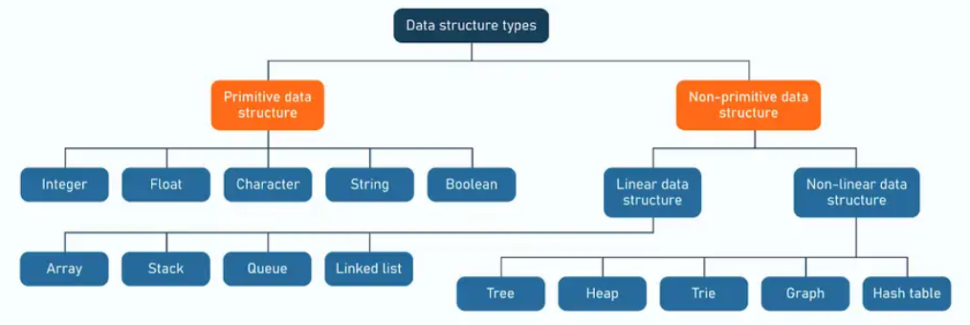
Classification of Data Structure

Slide 10
Classification of Data Structure
Linear Data Structure
Sequential Arrangement of Data
Not best for complex problem
Array, stack, Queue, Linked List
Non-linear Data Structure
Data arrangement not in sequential order (hierarchical manner)
One element may or may not connected to other elements
Graph, Tree and map

Slide 11
Classification of Data Structures
Primitive Data Structures
The most basic type of data structures, directly supported by the programming language.
Stored in memory with a fixed size.
Not defined in terms of other data structures.
Directly operated upon by machine instructions.
Int, Float, Character, Boolean
Non-Primitive Data Structures
Data structures that are built using primitive data types or other non-primitive data structures.
Can store multiple values.
Can have dynamic or static size.
More complex and provide advanced operations for handling data.
Arrays, Linked List, Stack, Queue, Trees and Graphs

Slide 12
What is Program
Definition of a Program:
A program is a set of instructions written in a programming language that tells a computer what to do.
Programs are designed to perform specific tasks or solve problems by interacting with hardware and software resources.
Program = Data Structure + Algorithm

Slide 13
Key Characteristics of a Program:
Set of Instructions: A program consists of a series of instructions executed by the computer.
Automation: A program automates tasks that would otherwise be manual, repetitive, or complex.
Input and Output: A program receives input from the user or other systems, processes it, and generates output.
Input
Processing
Output

Slide 14
Real-Life Example:
Making a Sandwich: A program is like a recipe where each step (instruction) must be followed to achieve the final result (a sandwich).
Step 1: Take two slices of bread.
Step 2: Add ingredients.
Step 3: Serve the sandwich
Any example in your Mind?? Take 2 minutes and discuss it

Slide 15
Components of an Algorithm
Input: Data given to the algorithm to process.
Output: The result or solution produced after processing.
Finite Steps: A limited number of steps.
Definiteness: Clear and unambiguous instructions.
Finiteness: Must terminate after a finite number of steps.
Effectiveness: Each step must be basic and executable.
Generality: Applicable to a broad set of inputs.

Slide 16
Example of an Algorithm
Preparing an Omelette
Input:
2 eggs
Salt and pepper (to taste)
Butter or oil
Optional fillings: Cheese, vegetables, ham, etc.
Step 1: Crack 2 eggs into a bowl.
Step 2: Add a pinch of salt and pepper to the eggs.
Step 3: Beat the eggs until fully mixed.
Step 4: Heat a non-stick pan over medium heat and add a small amount of butter or oil.
Step 5: Pour the beaten eggs into the hot pan.
Step 6: Let the eggs cook for a minute or two until the edges begin to set.
Step 7: (Optional) Add fillings like cheese, vegetables, or ham to one half of the omelette.
Step 8: Use a spatula to fold the omelette in half.
Step 9: Cook for another minute until fully set, then remove from the pan.
Output: A freshly made omelette ready to serve!

Slide 17
Example of an Algorithm
GPS Navigation System (Route Calculation)
Algorithm: Finding the Shortest Path
Input: A map with cities and roads (e.g., A to B, B to C, etc.), and a starting point and destination.
Step 1: Mark the starting city as the current city.
Step 2: Look at all possible roads leading from the current city and calculate the distance to each connected city.
Step 3: Choose the road that leads to the closest city (greedy step).
Step 4: Repeat the process for the newly selected city, considering all cities it can connect to.
Step 5: Continue this process until the destination city is reached.
Output: The shortest route from the starting city to the destination.

Slide 18
Pseudocode for GPS Routing:
1. Start from the current city
2. Find all neighboring cities and calculate distances
3. Choose the closest city and mark it as visited
4. Repeat until the destination city is reached
5. Return the path taken
Sorting Items in a Shopping Cart? (Take 5 minutes and write an algorithm for it

Slide 19
Computational Example of an ALgorithm
Finding the Maximum Number in a List
Algorithm:
Input: A list of numbers (e.g., [4, 7, 2, 9, 5]).
Step 1: Set the first number in the list as the maximum (max = 4).
Step 2: Compare each number in the list with the current maximum. If a number is greater than the current maximum, update the maximum.
Step 3: After comparing all numbers, return the maximum value.
Output: The maximum number in the list (9).

Slide 20
Qualities of an Algorithm
Finiteness: The algorithm must terminate after a finite number of steps.
Definiteness: Each step must be clearly defined and unambiguous.
Input: The algorithm takes zero or more inputs.
Output: It produces at least one output or result.
Effectiveness: The steps must be feasible and executable.
Generality: The algorithm should work for a wide range of inputs or problems.

Slide 21
How to evaluate a algorithm
Time Complexity: How fast the algorithm runs.
Space Complexity: How much memory it uses.
Correctness: Does it work for all inputs?
Efficiency: How well it uses time and space resources.
Scalability: Can it handle larger inputs?
Simplicity: Is the algorithm easy to understand and implement?

Slide 22
Time Complexity
Measures the amount of time an algorithm takes to run as a function of the input size.
Helps determine the efficiency of an algorithm, especially as the input size grows.
Common Time Complexities:
O(1): Constant time – Takes the same time regardless of input size.
O(n): Linear time – Time increases linearly with input size.
O(log n): Logarithmic time – Time grows logarithmically with input size.
O(n^2): Quadratic time – Time grows quadratically with input size.

Slide 23
Space Complexity and Correctness
Measures the amount of memory space an algorithm requires relative to the input size.
Common Space Complexities:
O(1): Constant space – Uses the same amount of space regardless of input size.
O(n): Linear space – Space required grows with input size.
An algorithm must produce the correct output for all possible valid inputs.
Evaluation Criteria:
Termination: The algorithm must always end after a finite number of steps.
Accuracy: The algorithm should always give the correct result.

